Slide 1
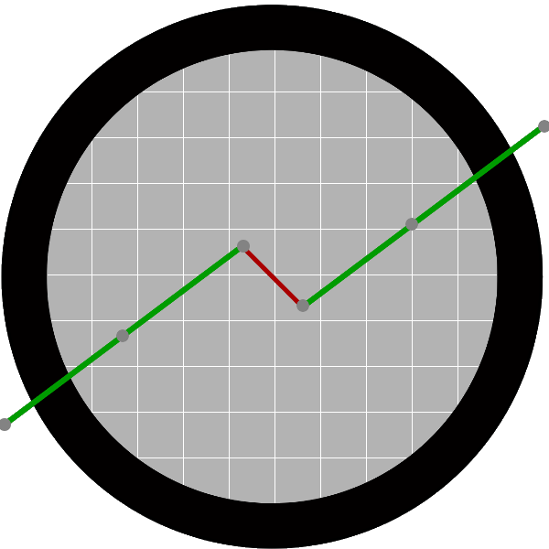

Introduction to Time Series Analysis
Fondren Library
Digital Scholarship Services

Slide 2
WHAT ARE TIME SERIES?

Slide 3
TRENDS AND SEASONALITY
How to filter out the noise and model what really matters

Slide 4
ACKNOWLEDGMENTS

